Slide 1

Stay Home, Stay Safe

Slide 2
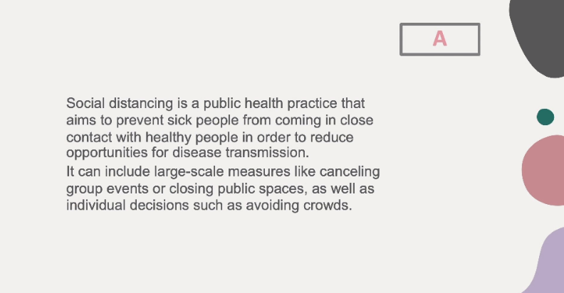

Slide 3
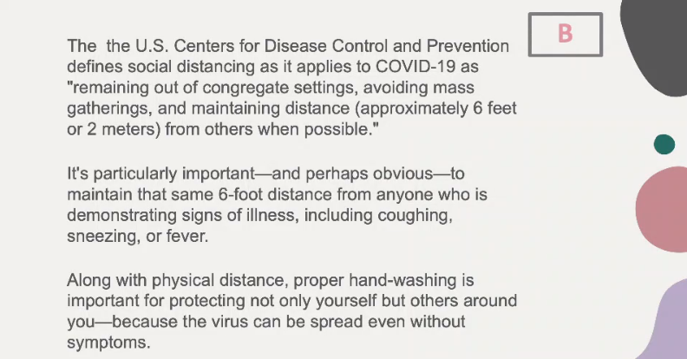

Slide 4

Practice
Social Distancing

Slide 5
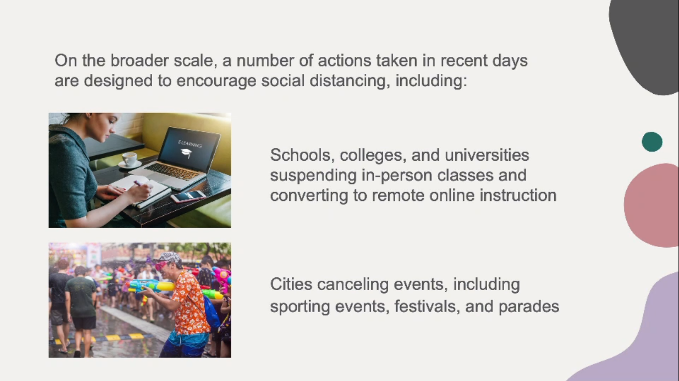

Slide 6
